Slide 1
FOUNDATION OF DATA SCIENCE
TRAFFIC ANALYSIS OF LONDON
TEAM 17 Dr. ANTONY SEBA P

Slide 2
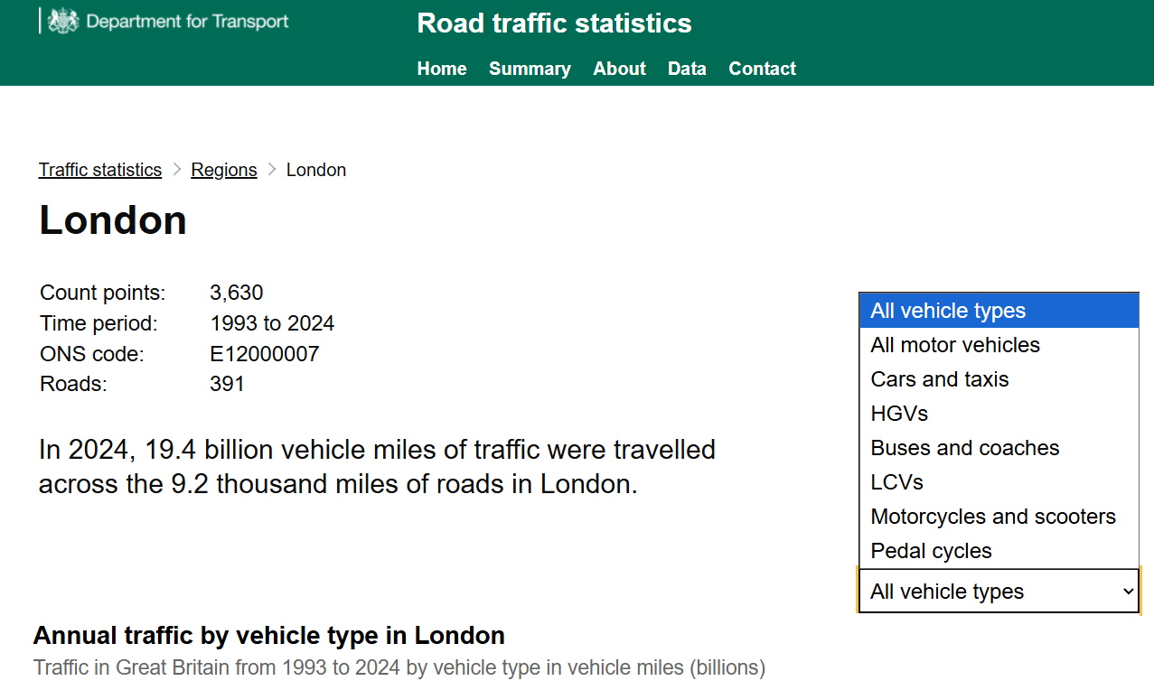
TRAFFIC DATASET
Dataset Source: Road Traffic open data
https://roadtraffic.dft.gov.uk/regions/6
Road traffic open data provides street-level data for every junction-to-junction link on the motorway and A road network
2 Datasets were chosen
Raw Counts: Vehicle counts recorded at this count point
Count Points: Count point in London details

Slide 3
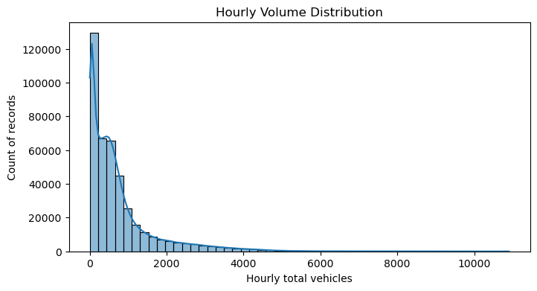
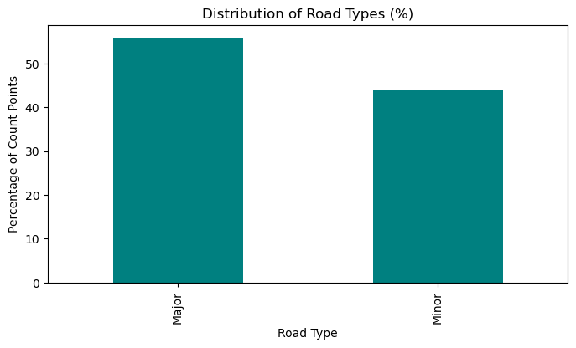
UNIVARIATE ANALYSIS
Hourly Volume Distribution
Observation: Most hourly volumes are low (<2000 vehicles), with very few extreme high values.
Importance: Indicates strong right skew; modeling may require scaling or log transform.
Distribution of Road Types
Observation: Not much of a class imbalance. 55%-45%
Importance: Count points are present in all types of roads

Slide 4
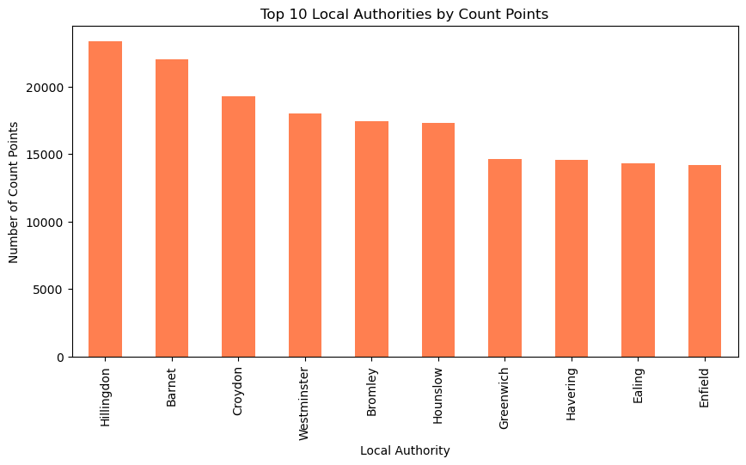
UNIVARIATE ANALYSIS
Local Authority
Observation: Few localities have higher traffic volume than others
Importance: Signifies which locality to give importance to

Slide 5
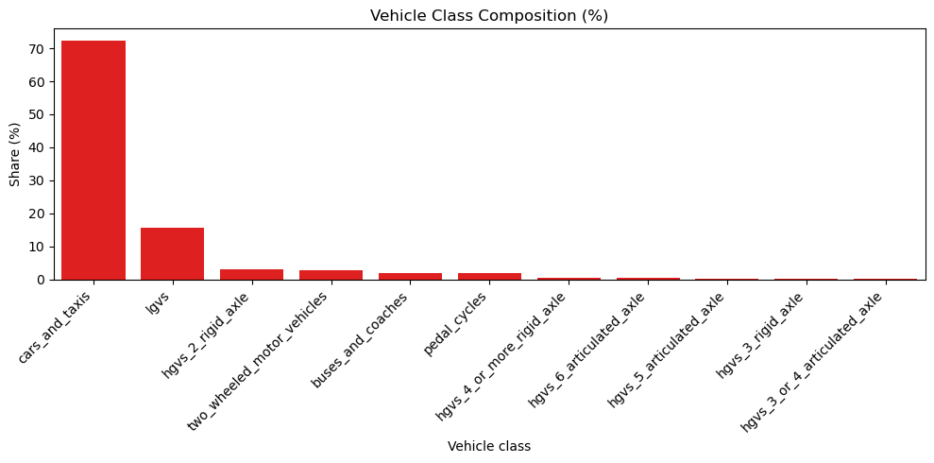
UNIVARIATE ANALYSIS
Vehicle Composition
Observation: Cars and taxis have 70% of traffic volume in London
Importance: Can indicate class imbalance

Slide 6
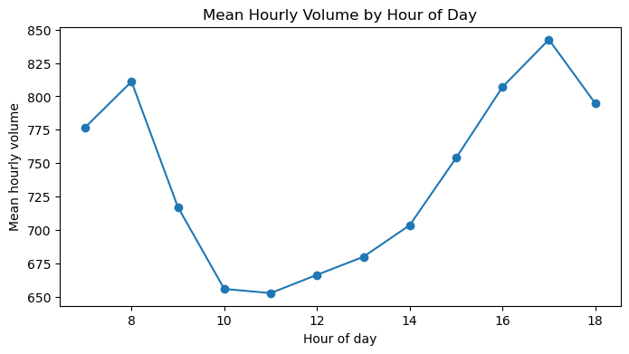
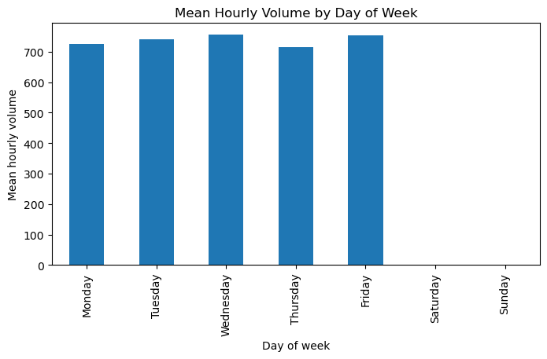
BIVARIATE ANALYSIS
Volume vs Time of Day (7-18h)
Observation: Sensor did not pick before 7am and after 6pm
Importance: Essential for traffic signal optimization and workforce scheduling decisions.
Volume vs Day of Week
Observation: Saturday and Sunday are not counted
Importance: Shows sensor and data source limitations

Slide 7
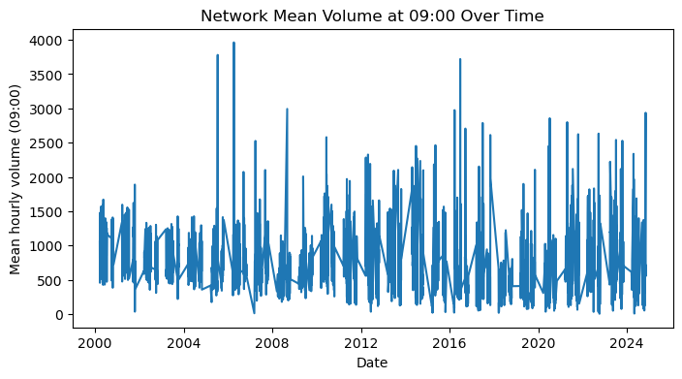
BIVARIATE ANALYSIS
Traffic Volume at 9 am
Observation: Few peaks in traffic counts are visible around 9 AM, indicating rush-hour spikes.
Importance: Capturing these peak periods is important for planning traffic management strategies.

Slide 8
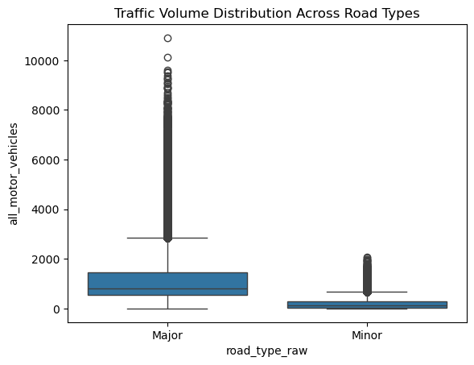
BIVARIATE ANALYSIS
Observation: Outliers in major road type. Has unusually high traffic volumes in major roads
Importance: Outliers can skew analysis and model performance. Should apply transformations

Slide 9
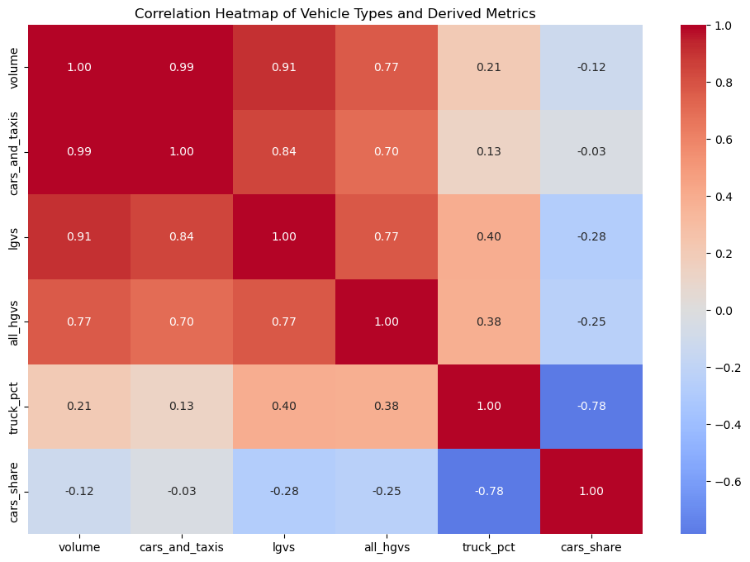
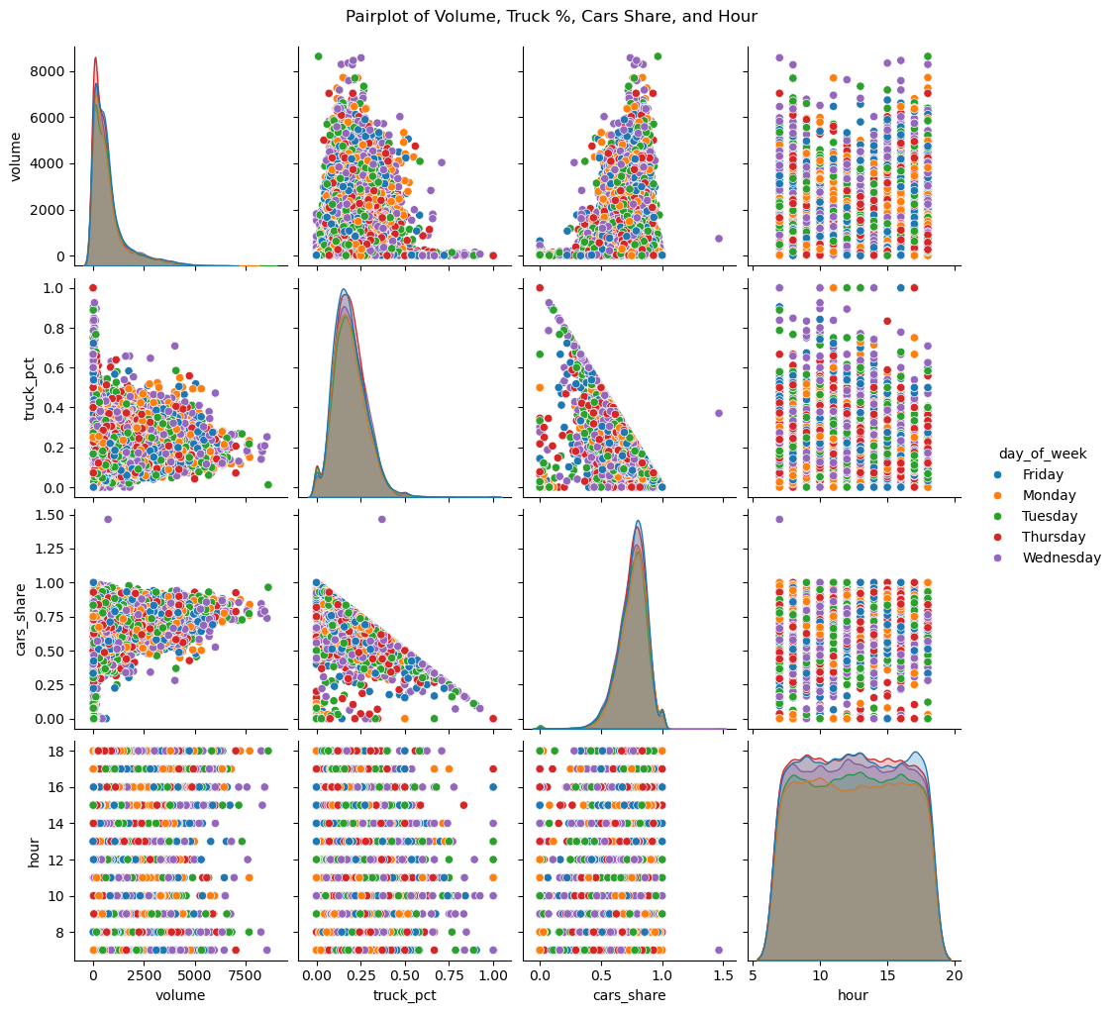
MULTIVARIATE ANALYSIS
Correlation Heatmap of Vehicle Types and Derived Metrics
Observation: Strong positive correlations (0.9+) between total volume and individual vehicle counts; truck percentage negatively correlates with cars share (-0.78).
Pairplot (Volume, Truck %, Cars Share, Hour)
Observation: Clear diagonal clustering in truck vs cars relationship; hourly patterns show bimodal distribution with day-of-week variations.

Slide 10
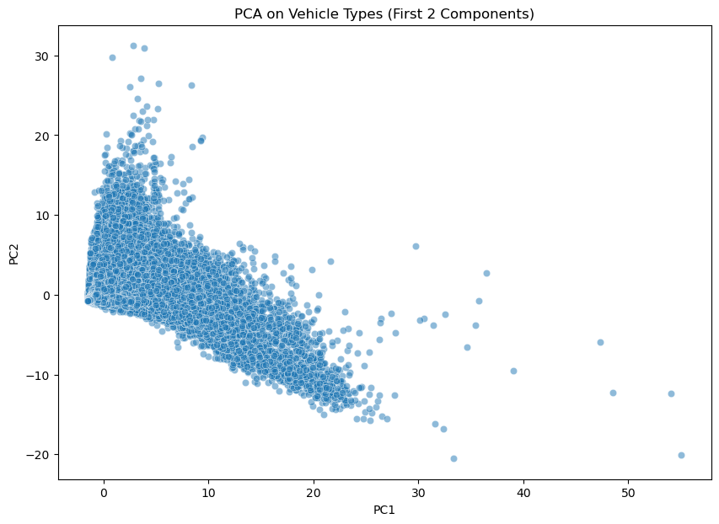
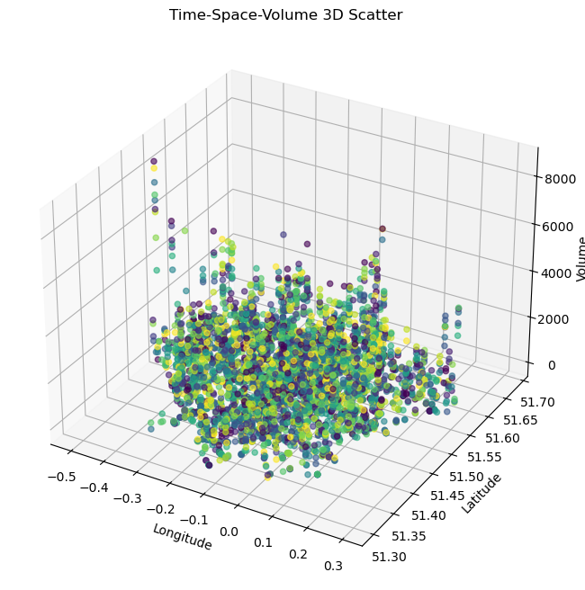
MULTIVARIATE ANALYSIS
PCA on Vehicle Types (First 2 Components)
Observation: Data forms continuous gradient from high-volume mixed traffic (left) to low-volume specialized traffic (right); no distinct clusters visible.
Time-Space-Volume 3D Scatter
Observation: Geographic clustering of traffic patterns with volume varying by London location; some high-volume outliers in specific coordinates.

Slide 11
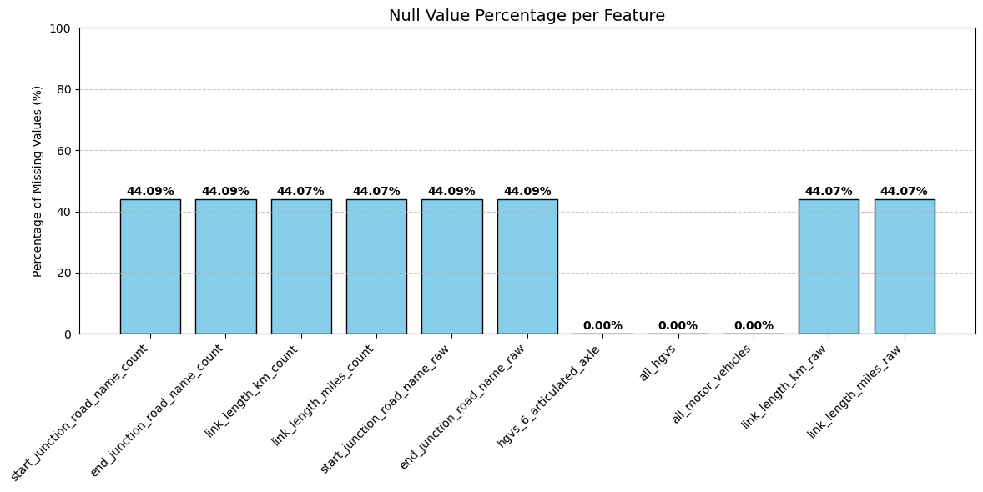
NULL VALUE PERCENTAGE
Total 11 features have null values
3 features have 1 null value
Rest 8 have 44% of null values

Slide 12
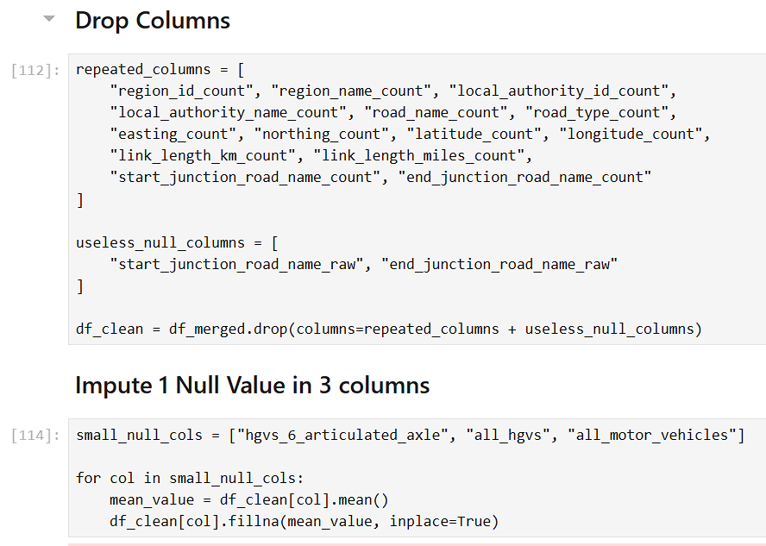
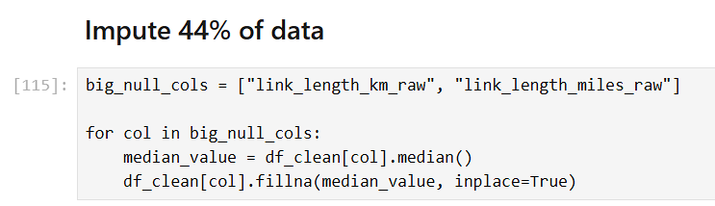
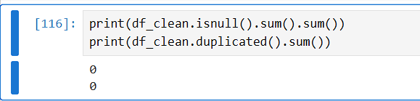
HANDLE NULL VALUES
4 null valued columns were dropped when dropping 14 repeated columns
2 columns were useless, so dropped
3 columns having 1 null value are imputed using its mean
2 columns with 44% of null values are imputed using its median

Slide 13
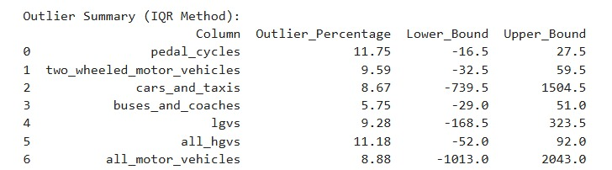
OUTLIER HANDLING

Slide 14
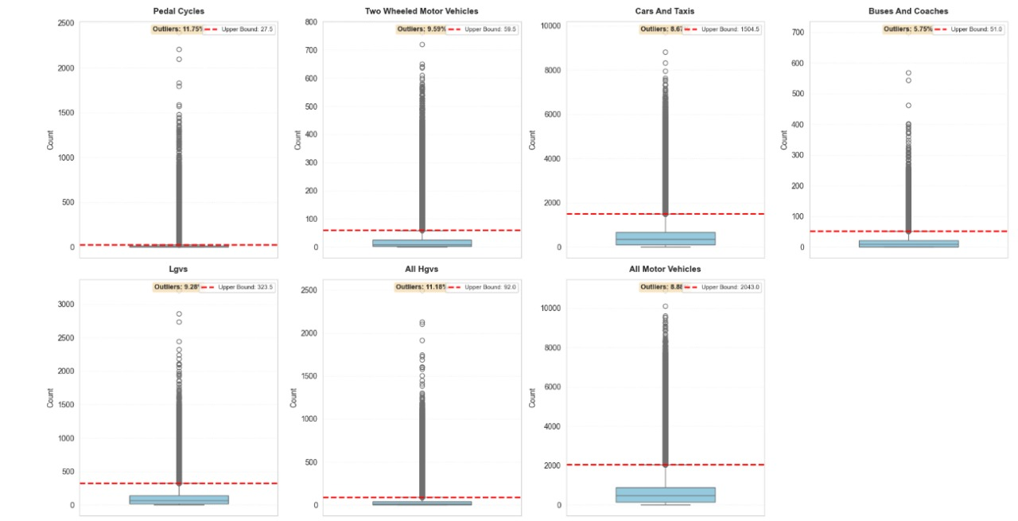
OUTLIER HANDLING

Slide 15
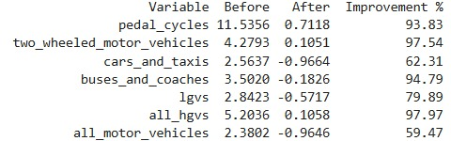
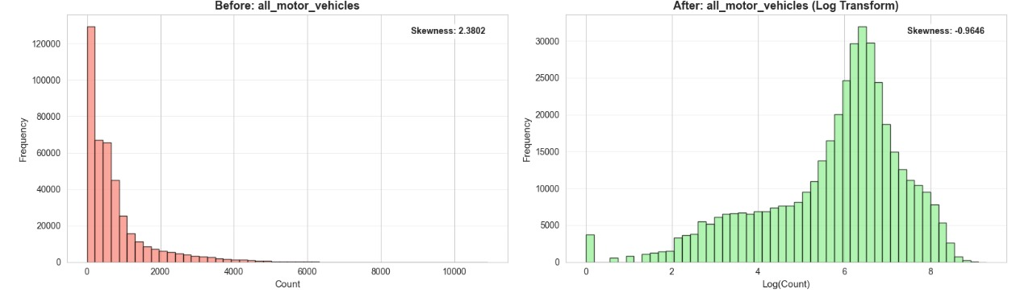
SKEWNESS

Slide 16
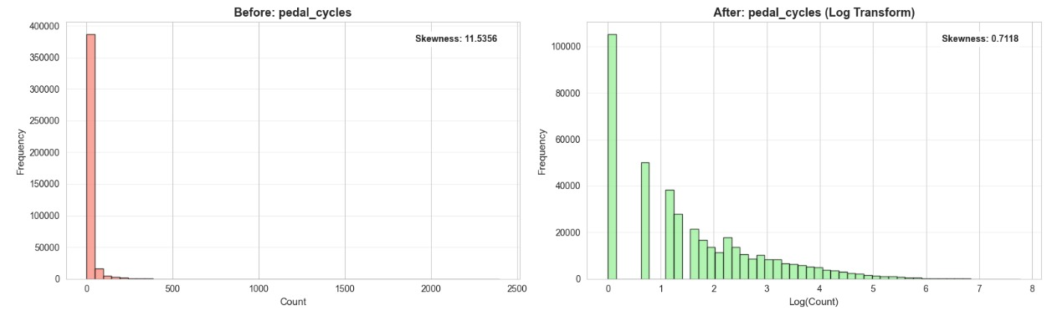
SKEWNESS

Slide 17
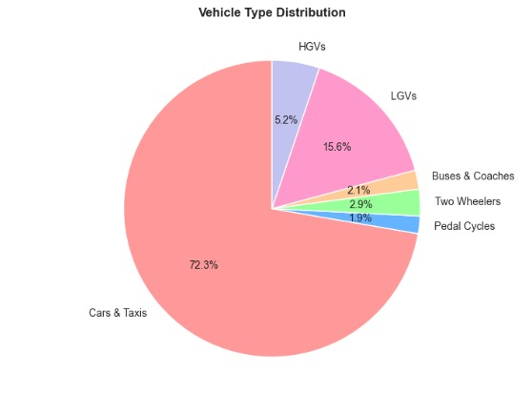
DASHBOARD

Slide 18
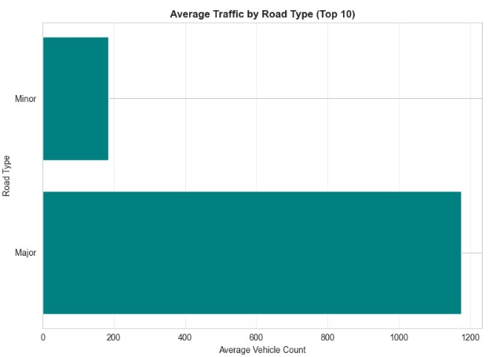
DASHBOARD

Slide 19
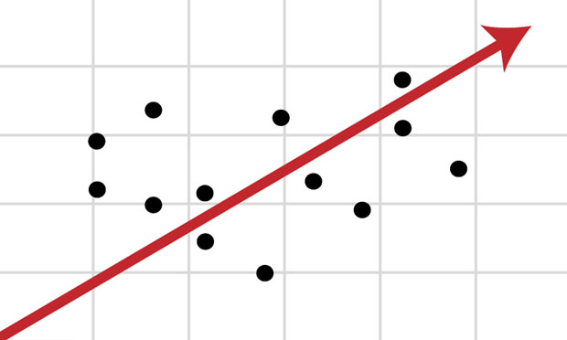
REVIEW 2 Model Building and Evaluation
Regression - Linear, SVM, DT, RF,AB,ANN
Classification - Logistic, SVM, DT, RF,AB,ANN
Visualization of metrices, tabulation of results

Slide 20
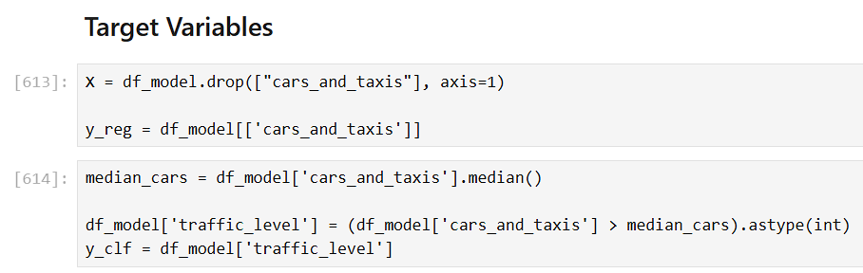
MODEL BUILDING
cars_and_taxi feature is chosen to be output for both regression and classification task
This represents largest proportion of vehicles travelling in London roads
Useful for urban management and congestion control

Slide 21
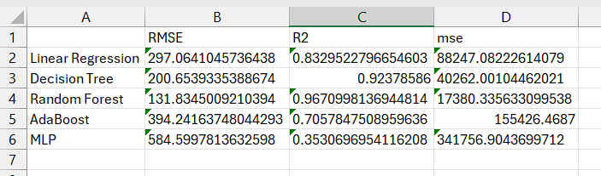
REGRESSION METRICS
Multilayer Perceptron gave best classification results
Random Forest Tree gave second best results

Slide 22
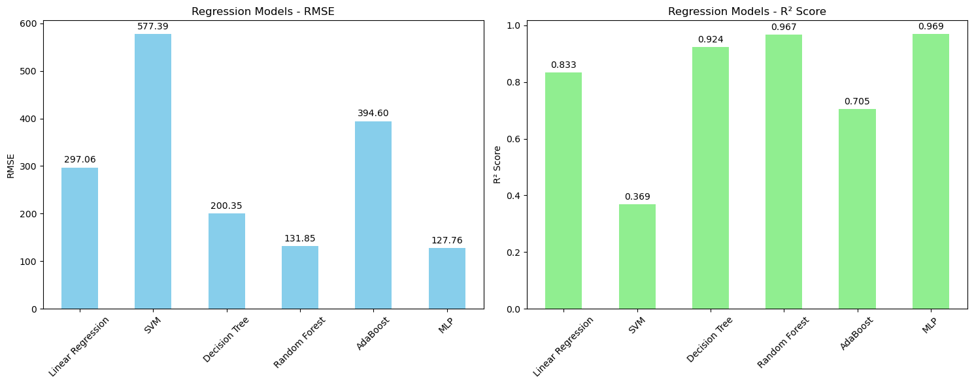
REGRESSION METRICS

Slide 23
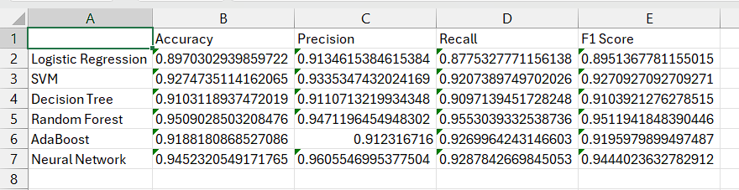
CLASSIFICATION METRICS
Random Forest Classifier gave best classification results
Multilayer Perceptron gave second best results

Slide 24
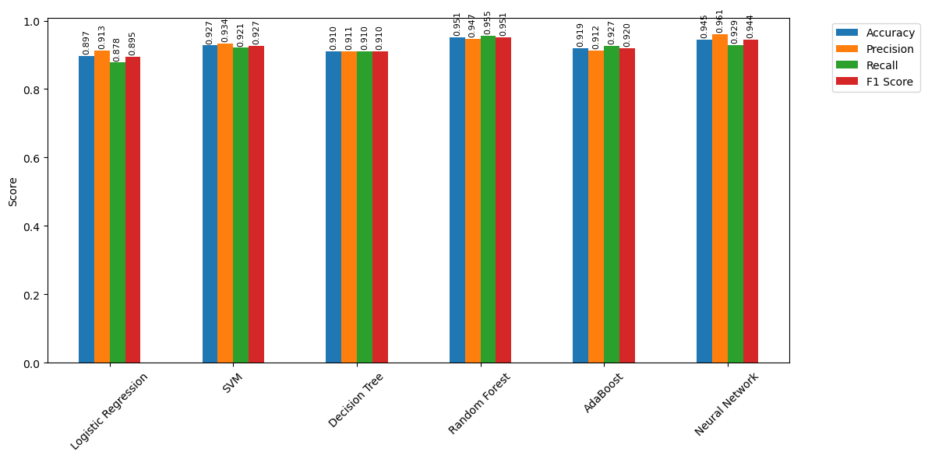
CLASSIFICATION METRICS

